Slide 1


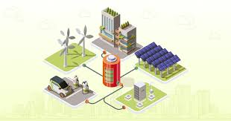
Title –
Design of IOT Architecture for
Battery Charging Management Technology
Major project 1st Review Presentation
Presented by
Jagadeesh_(AP2312210002)
under the Esteemed guidance of
Dr. Sujith Kalluri Ph.D
Associate Professor
School of Engineering and Sciences (SEAS)
Department of Electronics and Communication Engineering
SRM University, Andhra Pradesh (SRM AP)

Slide 2

Outline
Project study case and ideas
Smart charging Industry Study case
Akkodis Elmelin
Zypp Electric E Drift
Types of Charging Technology
- Real time Problems
- Solution with IOT

Slide 3

Smart charging Industry Study case
Akkodis
AI-based battery diagnosis
Modular, interchangeable batteries with cloud-based BMS
Predictive analytics for optimal charging and utilization
Elmelin
IoT-enabled thermal management
Real-time data analysis for proactive maintenance
Integration with smart grids for bidirectional energy flow

Slide 4
Smart charging Industry Study case
Zypp Electric
Fleet management and charging infrastructure
Sustainable charging with renewable energy integration
User-friendly mobile apps for charging access and battery health
E Drift
Smart charging stations with IoT-based monitoring
Data analytics for battery performance assessment and maintenance prediction
Integration with mobility services for seamless user experiences

Slide 5
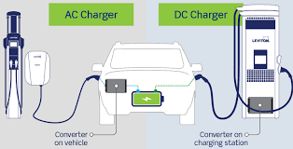
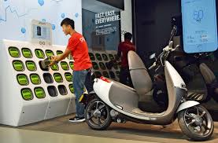
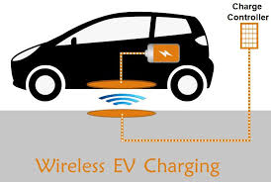
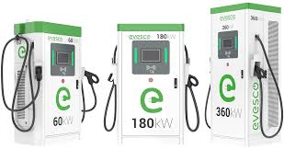
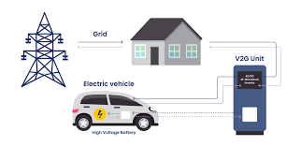
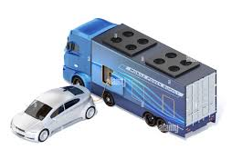
Types of Charging Technology
AC Charging
DC Charging
Battery Swapping
Wireless Charging
Vehicle-to-Grid (V2G) Technology
Fast Charging Technologies
Mobile charging

Slide 6
1. AC Charging
Problem:
Slow charging times can lead to user dissatisfaction and range anxiety for electric vehicle (EV) owners.
IoT Solution:
Implement a smart charging network that uses IoT sensors to monitor grid demand and adjust charging rates dynamically. By analyzing real-time data, the system can optimize charging schedules to reduce wait times while balancing grid load.

Slide 7
2. DC Charging
Problem:
High demand for fast charging stations can lead to congestion and longer wait times at charging locations.
IoT Solution:
Develop an IoT-enabled reservation system for DC charging stations. Users can book charging slots in advance through a mobile app, which also provides real-time updates on station availability and estimated wait times, improving user experience.

Slide 8
3. Battery Swapping
Problem:
Difficulty in locating nearby battery swapping stations and ensuring battery availability can hinder the adoption of battery swapping technology.
IoT Solution:
Create a comprehensive IoT platform that provides real-time data on battery swapping station locations, battery availability, and charging status. This platform can be integrated into navigation apps, allowing users to find the nearest station and check battery readiness before arrival.

Slide 9
4. Wireless Charging
Problem:
Inefficiencies in energy transfer during wireless charging can lead to energy losses and longer charging times.
IoT Solution:
Use IoT sensors to monitor the alignment and distance between the charging pad and the device. The system can adjust the power output dynamically to optimize energy transfer efficiency, minimizing losses and reducing charging time.

Slide 10
5. Smart Charging
Problem:
Users may not be aware of optimal charging times to take advantage of lower electricity rates, leading to higher costs.
IoT Solution:
Implement a smart charging app that analyzes electricity pricing data and notifies users when to charge their vehicles for maximum cost savings. The app can also automate charging during off-peak hours based on user preferences.

Slide 11
6. Induction Charging
Problem:
Limited range and efficiency of induction charging systems can restrict their application in public transport.
IoT Solution:
Integrate IoT technology to monitor vehicle positioning and charging efficiency in real-time. The system can adjust the charging frequency and duration based on the vehicle's speed and distance from the charging pad, enhancing overall efficiency.

Slide 12
8. Fast Charging Technologies
Problem:
High charging speeds can lead to battery degradation and safety concerns if not managed properly.
IoT Solution:
Develop an IoT-based Battery Management System (BMS) that continuously monitors battery health and adjusts charging rates accordingly. This system can prevent overheating and extend battery life by optimizing charge cycles based on real-time data.

Slide 13
9. Vehicle-to-Grid (V2G) Technology
Problem:
Lack of coordination between EV charging and grid demand can lead to inefficiencies and grid instability.
IoT Solution:
Implement a V2G management platform that uses IoT to communicate between EVs and the grid. This system can optimize energy flow based on real-time demand and supply, allowing EVs to discharge energy back to the grid during peak times and charge during off-peak hours.

Slide 14
9. Mobile charging for Remote areas
Problem:
Electric vehicles (EVs) encounter significant challenges in remote areas due to a lack of fixed charging stations, leading to "range anxiety" among drivers. This concern about running out of battery power before reaching a charging point discourages EV adoption in less accessible regions.
IoT Solution:
To develop a mobile charging network powered by IoT technology to provide reliable and accessible charging solutions for electric vehicles (EVs) in remote areas. This initiative aims to alleviate range anxiety among drivers and promote the adoption of electric vehicles in underserved regions.

Slide 15

Thankyou

